Slide 1
Credit EDA case study
Roshna Raj T M
Vivek Dumbre

Slide 2
Problem Statement
Identification of risk beforehand can always help organization to stay away from unforeseen debt which may impact the business of the organization.
Credit EDA aims to identify patterns which indicate if a client has difficulty paying their installments which may help understand the driving factors (or driver variables) behind loan default, i.e. the variables which are strong indicators of default.
This will ensure that the consumers capable of repaying the loan are not rejected by the loan providing company.

Slide 3
Analysis Approach Followed
Handling Missing values from the dataset and making it consistent.
Checking for Outliers/non-admissible values and handling them appropriately.
Univariate analysis and Bivariate analysis of selected variables.
Identifying the variables having significant correlation with target variable and retaining them.
Obtaining the data imbalance ratio.

Slide 4
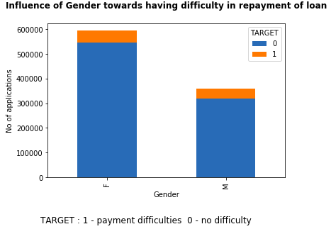
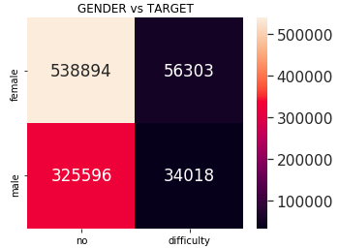
Influence of Gender

Slide 5
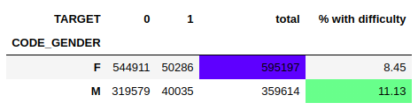
We saw that there is significant difference between the proportions using confidence interval.
Here we have more applicants from females whereas males have had more (11.13%) difficulty in repaying the loan.
However the proportions of females and males having difficulty in payment are not high enough to refuse loans to either of the category

Slide 6
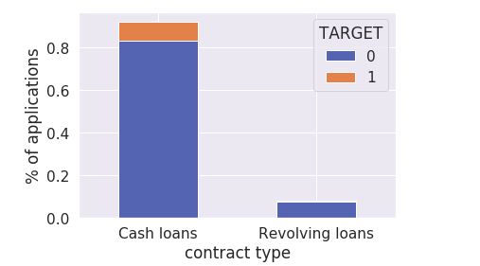
Influence of contract type
From the results of Chi-square test, we could say that the contract type has an influence in determining whether a person has difficulty in repayment of loan. Here in our sample we see that there is no defaulters in 'Revolving loans' category. However this could be even due to not enough representative data.

Slide 7
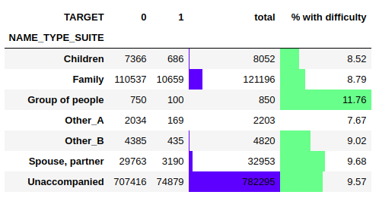
Influence of accompany type
When we look at top 2 categories, ‘Family’ and ‘Unaccompanied’, the proportions are not high enough to refuse loans to any group. ‘Group of people’ category has slightly higher proportion of having difficulty in repayment of loan.

Slide 8
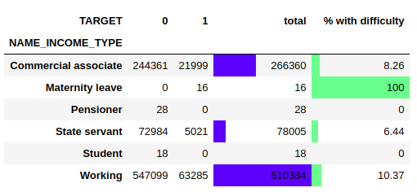
Influence of income type
Here though we can say that working professionals are more likely to take loans and only 10.37% of them have chance of having payment difficulties. Hence, it is better to do campaigns for this set of group.
Here we observe that those who has taken maternity leave had all of them subject to difficulty in repayment. Hence, that can be a risky group to provide loans to.

Slide 9
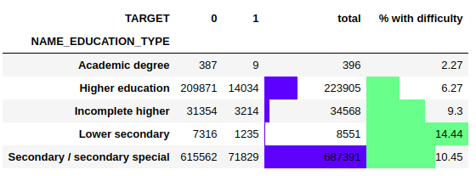
Influence of education type
We see that persons having lower secondary education has higher proportion (14.44%) of having difficulty in payment of loan. Hence, it is risky to provide huge loans to this category.
People belonging to secondary education has the highest number of applicants. Hence, it is better to do campaigns focusing on these category by offering packages in the fields in which this category persons are most likely to take up career as only 10.45% of them have had payment difficulties.

Slide 10
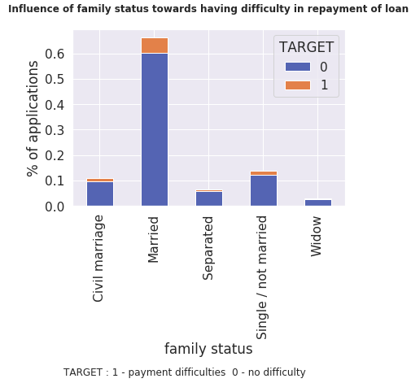
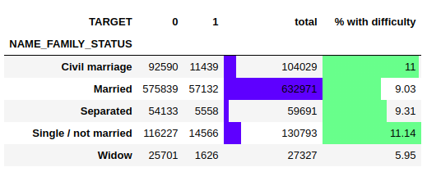
Influence of family status
Highest number of persons opting for loan are from Married category and only 9.03% of them have had difficulty in repaying loan.
Hence, campaigns should focus on this category. Even if 11.14% of singles have had payment difficulties, they are second top categories taking up loans, part of the campaign should also be dedicated to this category.

Slide 11
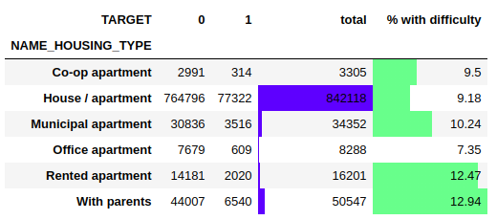
Influence of housing type
Persons having house/apartment are more likely to take up loans and only 9.18% of them have had difficulty in repaying the loan. Again, this is potential category, hence campaigns should focus on this category.
Here we see that persons with rented apartments and staying with parents have the top two percentages in having difficulty in repayment of loan, even though this % is not that high.

Slide 12
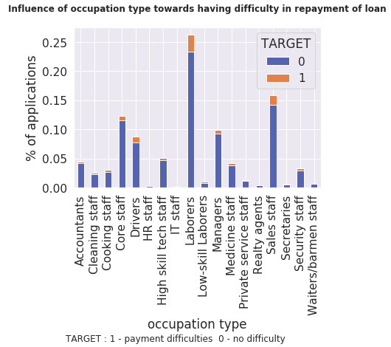
Influence of occupation type
Here we see that highest number of persons opting for loans are Laborers and % of persons having difficulty in repayment is just 11%.
Hence, this is a potential category for doing the campaign for.

Slide 13
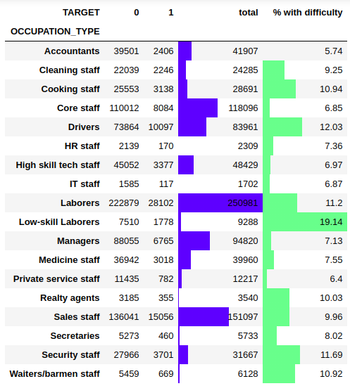
As we see that low-skilled laborers have the highest percentage (19.14%) of persons having difficulty in payment.
So providing high amount of loans to these category of persons may bring huge debt for the company.

Slide 14
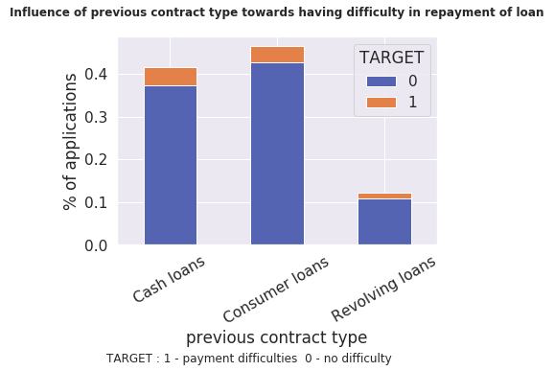
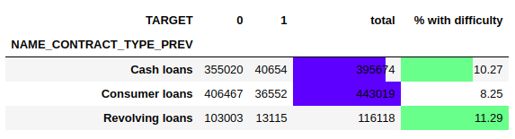
Influence of previous contract type
Most of applicants had previous contract type as ‘Consumer loans’ and also the % of persons among them having difficulty in repayment of loan is also less (8.25%).
Hence following up people who has taken revolving loan can help the business.
As we see from the highlighted table, persons with previous revolving loans had higher percentage (11.29%) of having difficulty in repayment of loans.

Slide 15
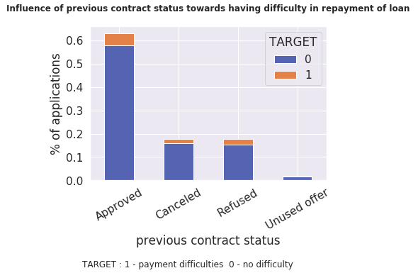
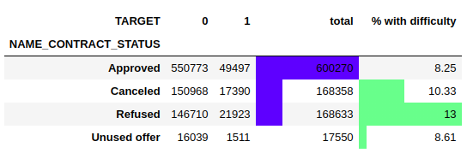
Influence of contract status
Here we see that persons whose previous application was approved have opted for loans again mostly and their percentage of having difficulty in repayment of loan is also very less being 8.25%.
We can also conclude from the table that people whose previous application was refused by the company is more susceptible to having difficulty in repaying loan.

Slide 16
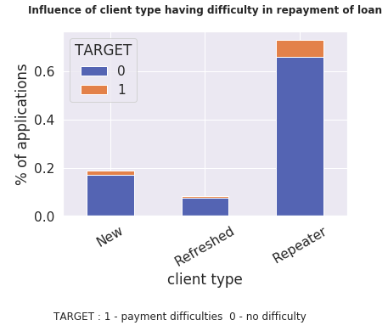
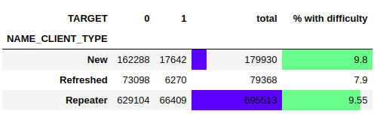
Influence of client type
We see that previous clients have opted for loan again most of the time.
Hence, following up older clients may benefit the organization as the percentage of them having difficulties in repayment of loan is also less, i.e.,9.55%.

Slide 17
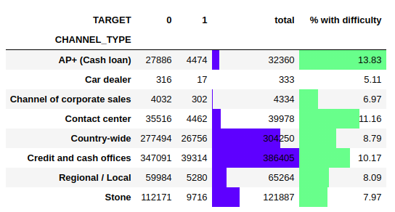
Influence of channel type
Here we see that most of the applications have come through Credit and Cash Offices and their % of risk is also not that high.
Also it is observed that proving high loan amount through channel type 'AP+ (Cash loan)' is risky as 13.83% for them had difficulty in repaying the loan.

Slide 18
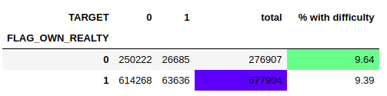
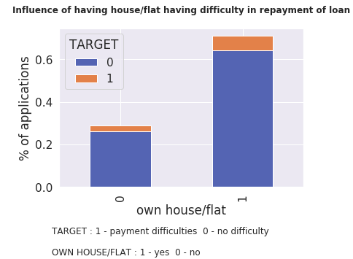
Influence of owning a house/flat
Even if we obtained that there is significant difference between the proportions. These proportions are not high enough to refuse loans to any of the category.

Slide 19
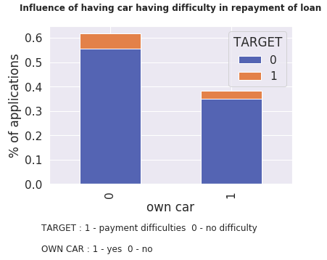
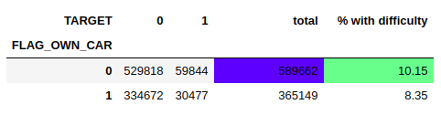
Influence of owning a car
We obtained that owning a car has association with determining whether a person can have payment difficulties with person not owning a car having slightly higher chance (10.15%) of having difficulty in repayment. However, since the number of applicants is more from people not owning car, it is not suggested to refuse loans for any group.

Slide 20
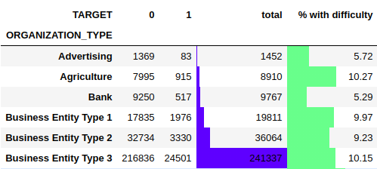
Influence of organization type
The top two clients are from organization types 'Business Entity Type 3' and Self-employed.
The client belong to organization type 'Transport: type 3' has high chance of having difficulty in repayment of loan. Hence lending high amounts as loans to this group may be risky for the company.

Slide 21
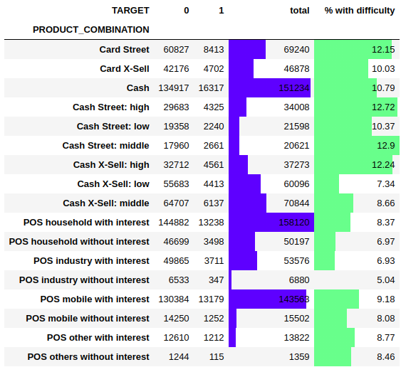
Influence of product combination
Top clients based on product combination category belongs to POS household with interest and the % of having payment difficulty is also less i.e., 8.37%
The categories among product combination having highest payment difficulties belongs to :
1. Cash Street: middle
2. Cash Street: high
3. Cash X-Sell: high
4. Card Street

Slide 22
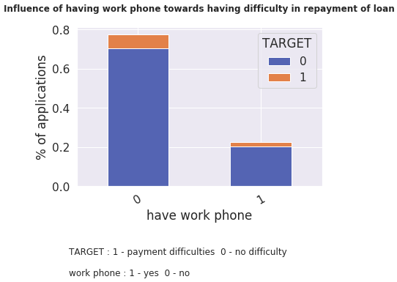
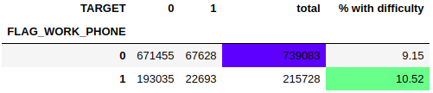
Influence of work phone
Most of applications have come from people who don’t have work phone.
We see that % of persons having difficulty in payment is higher for people who provided work phone,
But this is not sufficient enough since the % is lower and hence provide with no reason to refuse loan to them.

Slide 23
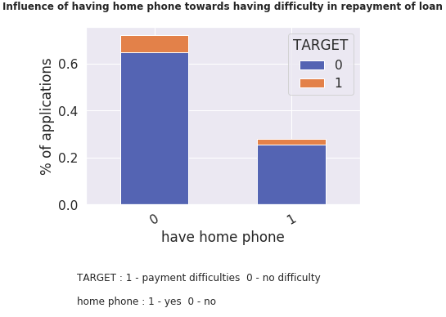
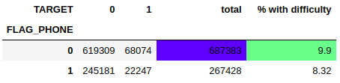
Influence of having home phone
Here we see that persons who did not provide home phone had little higher chance of having repayment of loan.
However, the percentage is less and hence do not provide sufficient evidence to refuse loan to them.

Slide 24
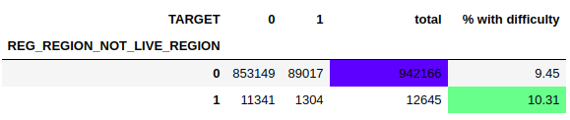
Influence of not living in applied region
Most of the people who applied for the loan live in that region.
Here we see that persons not living in applied region has higher chance of having difficulty.
However, we see that % of persons having difficulty in both cases are not high enough to refuse loan to any of the group.

Slide 25
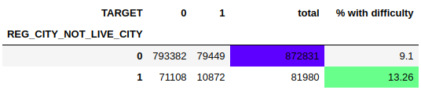
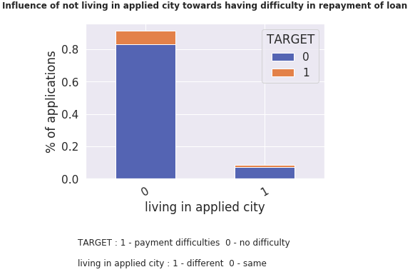
Influence of not living in applied city
Most applicants live in the applied city. Here we see that the persons who do not live in the applied city had higher chance (13.26%) of having payment difficulties.

Slide 26
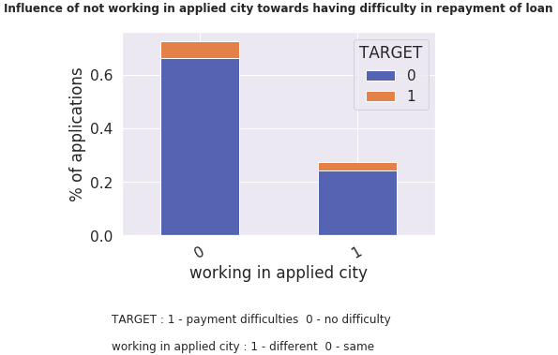

Influence of not living in applied city
Most of the people work in the applied city itself.
Here we see that the persons who do not work in the applied city had higher chance (11.35%) of having payment difficulties.

Slide 27
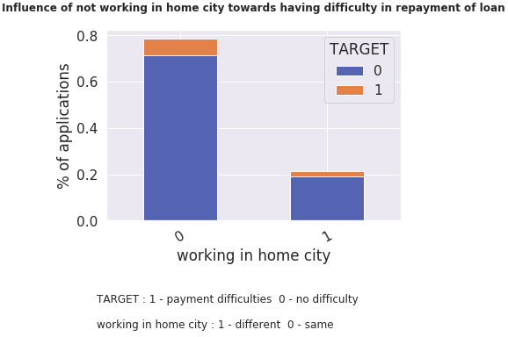

Influence of not working in home city
Applicants who do not work in the home city have higher (10.68%) chance of having payment difficulties.

Slide 28
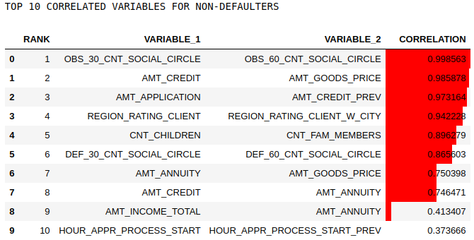
Top 10 Correlation : Non-Defaulters

Slide 29
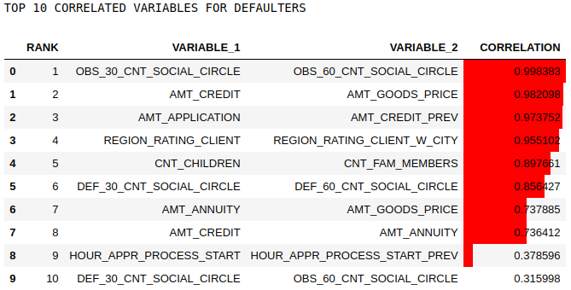
Top 10 Correlation : Defaulters

Slide 30
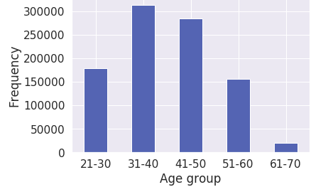
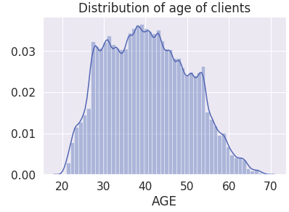
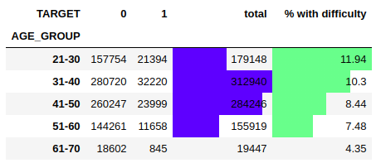
Influence of age

Slide 31
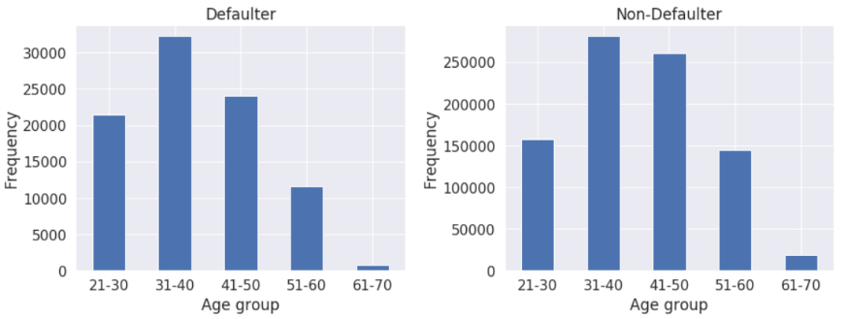
Here, we see most of the clients belonging to the age-group 31-40 and hence campaigns should focus on this category since the % of people having difficulty in repayment is also less (10.3%).
However people in the age-group 21-30 has comparatively higher chance of having defaulters (11.94%).
We analyzed that for the frequency distribution of both for defaulter and non-defaulter groups, the ranks of age-groups according to their frequency are same.

Slide 32
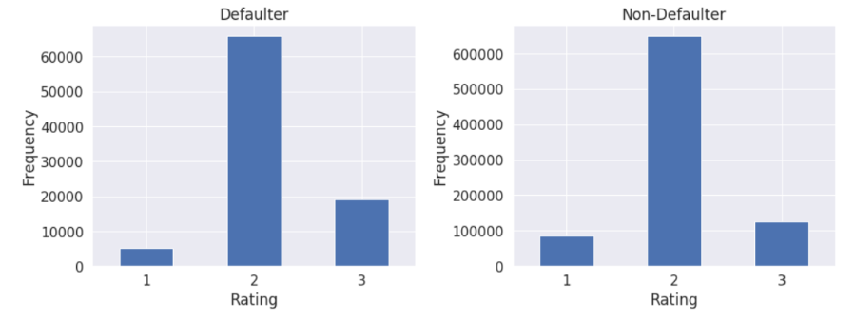
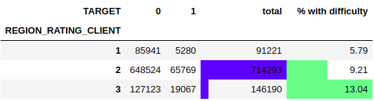
Influence of region rating
Here also we see that both for defaulter and non-defaulter groups, ranking of different ratings according to their frequency are same.
Here we see that persons from regions with ranking 2 have applied for the loans the most and their risk is also less (9.21%). Hence campaigns should focus on these regions.
However we see that 13.04% of persons belonging to region with rating 3 had payment difficulties. Further investigation may be done as why that region has this tendency.

Slide 33
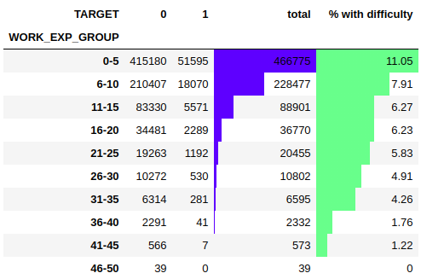
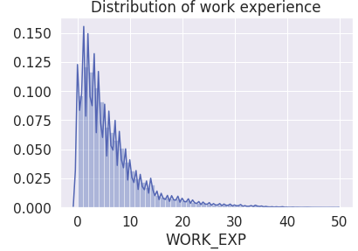
Influence of work experience

Slide 34
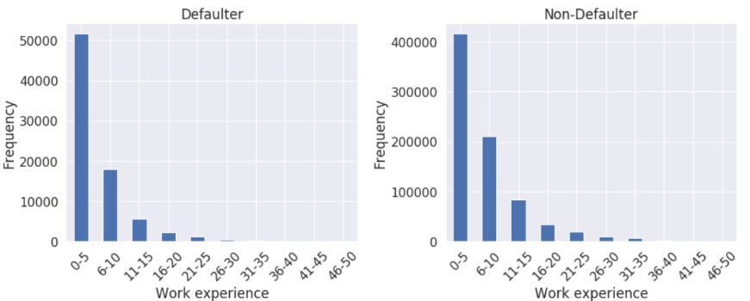
We see that people with work experience 0 to 5 range have applied for the maximum loan.
Even though 11.05% of them had payment difficulties, comparing to the prominent audience, we should focus on this category while having campaign.
Here also we that the ranking for each work experience group is same for both defaulter and non-defaulter groups according to frequency.

Slide 35
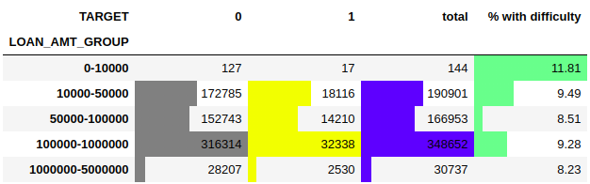
Influence of loan amount
We see that here we have highest number of applicants from the amount group 1 lakh to 10 lakh and they
have very less proportion (9.28%) of peoples having difficulty in repayment of loan. Hence, more loan plans
should be provided in this loan range.
Also the persons opting less amount of loan i.e., below 10000 have more percentage (11.81%) of people
having difficulty in repayment of loan.

Slide 36
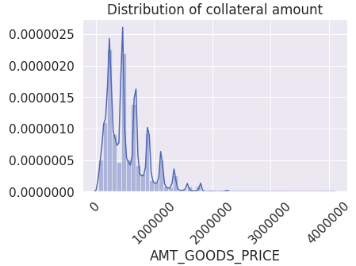
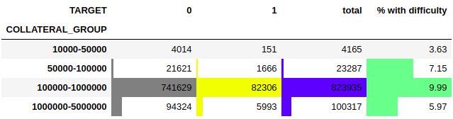
Influence of collateral amount
Here we see that most of the collateral amounts to the range 1 lakh to 10 lakh.
Here we see that none of the group has high enough percentage of people having difficulty in repayment.

Slide 37
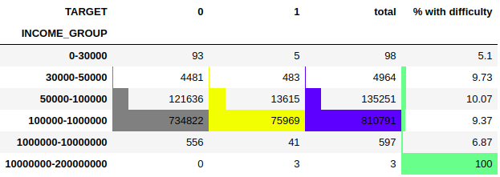
Influence of income
Here we see that persons with income 1 lakh to 10 lakh have opted for loans most of them and with very less percent (9.37%) of them having difficulty in repayment of loan. Hence campaigns should focus on this income group.
Here in the income group above 1 crore, there is high % of defaulters found. An investigation may be needed as to why this is observed.

Slide 38
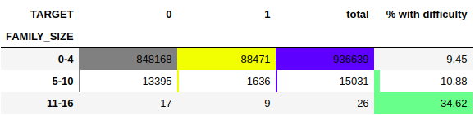
Influence of family size
Here we have maximum family members as 16. We cannot still confidently tell this is a non-admissible value. There can be joint families which may probably have this number.
Hence, we can bin them for convenience.
Here we observe that nuclear families with 0-4 members have applied for maximum loans and have very less percentage (9.45%) of applications having difficulty in repayment of loan.
Hence, campaigns should be made for nuclear families to attract more potential subscribers.
Families with very large number of members have more chance of having difficulty in repayment of loan.
Hence a family size of more than 10 members must be risky for loan approval.

Slide 39

Influence of social circle
Here we see that maximum number of applicants have come from surroundings with no defaulters 30 days past due and also the percentage of people having difficulty among them is also less (9.1%).
When the number crosses 3, it may be quite risky to lend loan to them. However, looking at the percentages for numbers 1, 2 and 3, we see that this may not be always the case.
Hence, no sufficient evidence to completely suspect these groups.

Slide 40

Data Imbalance
As we can see that our final data has high data imbalance with defaulted population at 9.5% as compared to
non-defaulted population at 90.5%.
Imbalance ratio was found to be 9.56.

Slide 41
THANK YOU

